Slide 1


Amrita Vishwa Vidyapeetham
Department of Electronics and Communication Engineering
23ECE381 Open Lab- 1
LDR Logic-Based Color Detection and Sorting System
PROJECT
REVIEW – 2
Group Members:
Aathithya Pranav - CB.EN.U4ECE23002
Adarsh B - CB.EN.U4ECE23004
Ezhilkirthik M - CB.EN.U4ECE23016
Batch-A02​

Slide 2
OBJECTIVE
To design and implement color detection and sorting system.
To accurately identify and classify up to seven colors (Red, Green, Blue, Cyan, Yellow, Magenta, White) using LDRs with RGB optical filters.
To convert optical color signals into digital logic codes through comparators and decoders.
To enable real-time automated sorting of objects on a conveyor system using servo motor mechanism
To demonstrate a low-cost, reliable, and autonomous solution for industrial and laboratory applications.
1

Slide 3
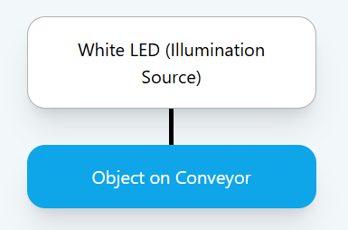
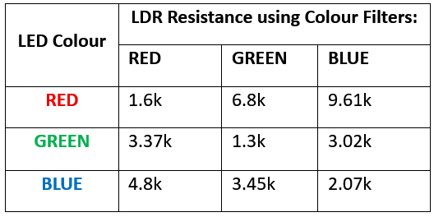
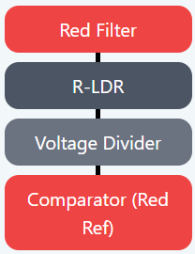
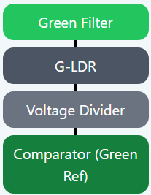
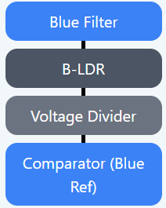
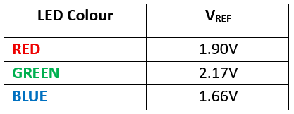
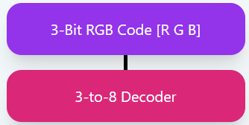

02
BLOCK DIAGRAM

Slide 4
Components Used
03
555 Timer IC
Resistors
Capacitors
LM358 IC
Servo Motor
8-channel analog multiplexer IC
BCD-to-7-segment decoder IC
7 Segment Display (Cathode)
Potentiometers
LDR
DSO

Slide 5

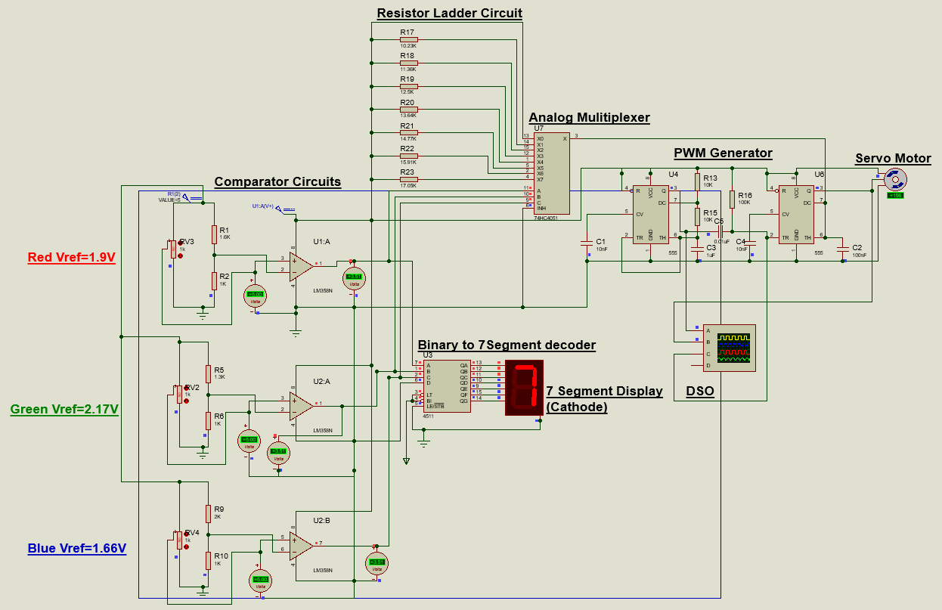
04
CIRCUIT DIAGRAM

Slide 6
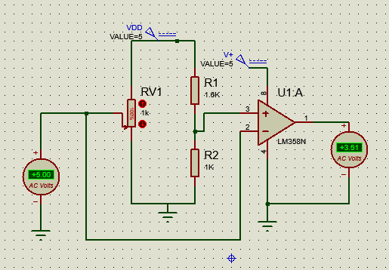
05
DESIGN
Comparator Design
-
+

Slide 7
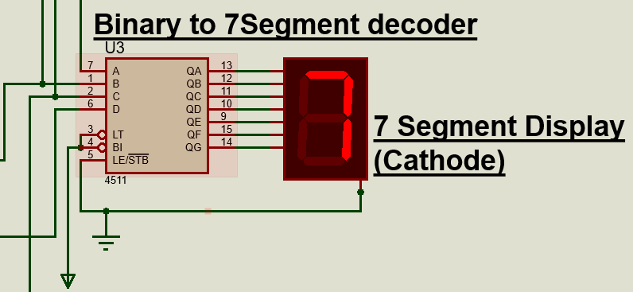
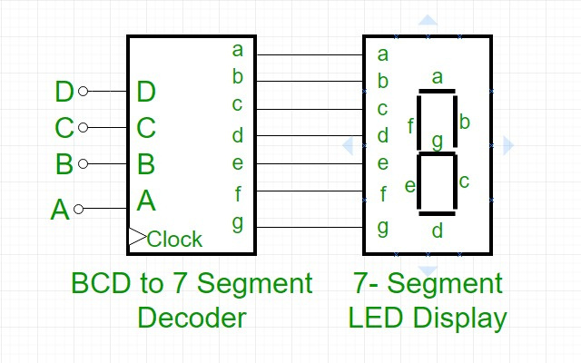
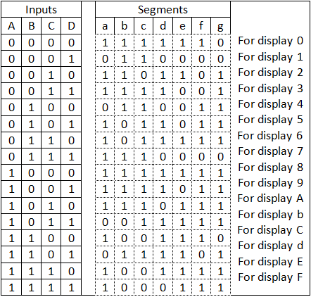
06
DESIGN
Decoder Design
D C B A
Reference Circuit

Slide 8
07
DESIGN FORMULAS
Astable Multivibrator:
T_high​ = 0.693*C1​*(R1​+R2​)
T_low​ = 0.693*C1*⋅R2​
T = T_high ​+ T_low​
Monostable Multivibrator:
T = 1.1*R*C
Resitor Ladder R Value:
R = T/(1.1*C)

Slide 9
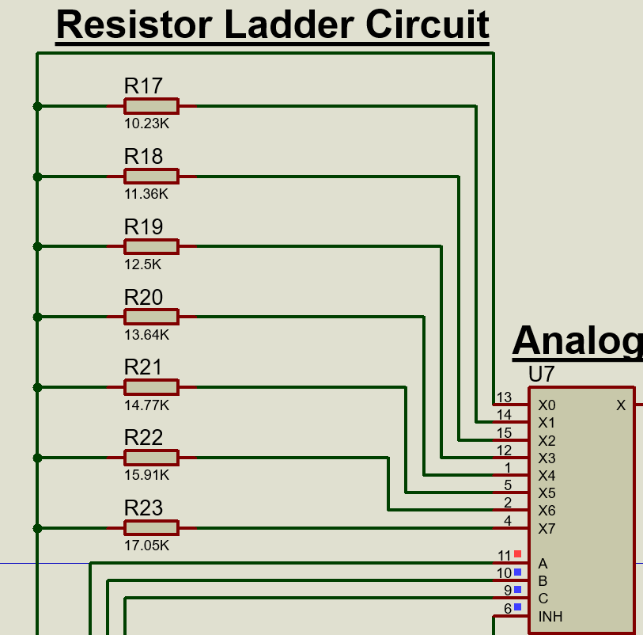
08
DESIGN VALUES
Servo Rotation (°) | Pulse Width (ms) | Resistor Values (R) | T = 1.1*(R)*C
0 | 1 | 0 | 1
22.5 | 1.125 | 10.23K | 1.122
45 | 1.25 | 11.36K | 1.248
67.5 | 1.375 | 12.5K | 1.375
90 | 1.500 | 13.64K | 1.5
112.5 | 1.625 | 14.77K | 1.628
135 | 1.75 | 15.91K | 1.749
157.5 | 1.875 | 17.05K | 1.8755

Slide 10
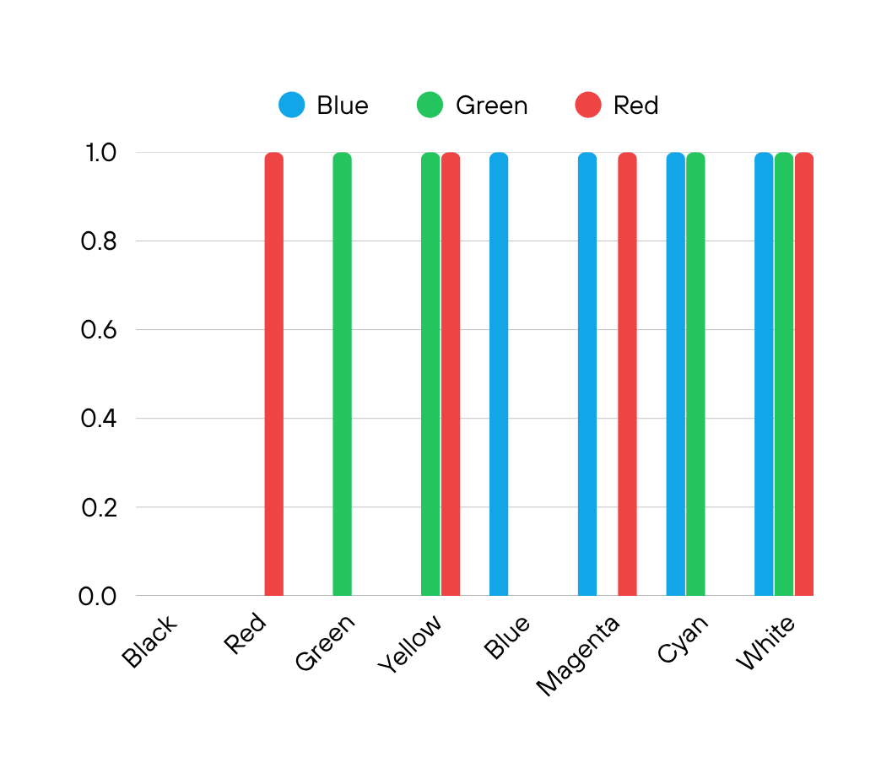
Analysis
7 Segment Display Code | Blue | Green | Red | Output | Servo Rotation (°) | Pulse Width (ms)
0 | 0 | 0 | 0 | Black | 0 | 1
1 | 0 | 0 | 1 | Red | 22.5 | 1.125
2 | 0 | 1 | 0 | Green | 45 | 1.25
3 | 0 | 1 | 1 | Yellow | 67.5 | 1.375
4 | 1 | 0 | 0 | Blue | 90 | 1.500
5 | 1 | 0 | 1 | Magenta | 112.5 | 1.625
6 | 1 | 1 | 0 | Cyan | 135 | 1.75
7 | 1 | 1 | 1 | White | 157.5 | 1.875
09

Slide 11
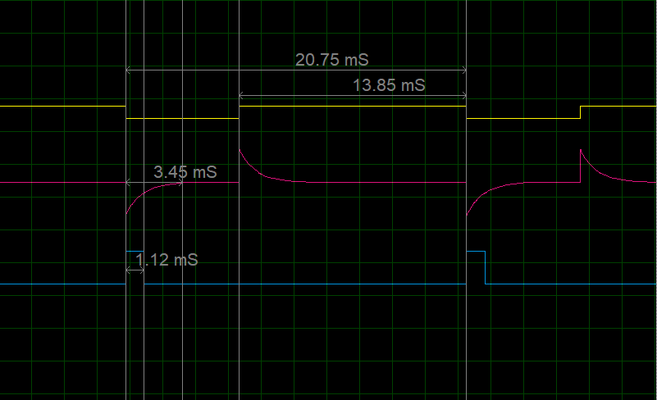
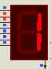
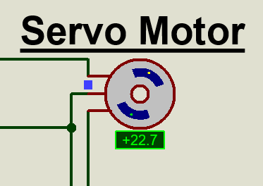
Analysis
10

Slide 12
REFERENCE
[1] I. Mazumdar, R. Mondal, and S. Pal, “Design and development of a low cost colour sensor and its application in angular position control system of a stepper motor,” Int. J. Electron. Comput. Sci. Eng., vol. 2, no. 4, pp. 1241–1251, 2013.
[2] T. K. Binnar, D. D. Deoghare, P. N. Patil, and V. S. Kulkarni, “Designing of RGB color detector,” Int. J. Recent Dev. Eng. Technol., vol. 3, no. 2, p. 12, Aug. 2014.
[3] M. Petersen et al., “Conveyor line color object sorting using a monochrome camera, colored light and RGB filters,” in Proc. 23rd Annu. Hawaii Int. Conf. Educ., Honolulu, HI, USA, Jan. 4–7, 2025.
11
[4] A. Amhani and Z. Iqbal, “Automated color sensor system using LDR and RGB LEDs controlled by Arduino,” ARPN J. Eng. Appl. Sci., vol. 12, no. 19, pp. 5532–5535, Oct. 2017.
[5] C. Tran, “Automobile tail lamp and brake lamp controller,” Analog Dialogue, vol. 43, Dec. 2009. [Online]. Available: C. Tran, "Automobile Tail Lamp and Brake Lamp Controller," Analog Dialogue, vol. 43, Dec. 2009. Available: https://www.analog.com/en/resources/analog-dialogue/articles/automobile-tail-brake-lamp-controller.html. [Accessed: Sep. 18, 2025].
[6] Virtual Labs, IIT Roorkee, “Astable and Monostable Multivibrator,” Virtual Labs. [Online]. Available: https://ae-iitr.vlabs.ac.in/exp/astable-monostable-multivibrator/theory.html. [Accessed: Sep. 18, 2025].

